Slide 1


DEVELOPING A FLIGHT PRICE PREDICTION MODEL USING MACHINE LEARNING AND DATA WAREHOUSING TECHNIQUES
PRESENTED BY:
GIRIJA B [192311044]
CSA1618 - DATA WAREHOUSING & DATA MINING
WITH DETECTION AND EXTRACTION

Slide 2

Introduction
Flight ticket prices vary dynamically based on multiple factors such as airline type, departure and arrival locations, travel duration, and the number of stopovers. The unpredictability of these prices makes it challenging for travelers to find cost-effective options. This project aims to develop a Flight Price Prediction System using machine learning techniques, primarily the Random Forest Regressor, to predict airfare prices based on historical data.
The system involves data collection, preprocessing, feature engineering, and model training to ensure accurate predictions. A user-friendly web interface (Streamlit) allows users to input travel details and receive real-time price estimations. The model is deployed using Flask API, ensuring smooth communication between the backend and the web application. By implementing data warehousing concepts for efficient data management, this project enhances decision-making for travelers, airlines, and travel agencies.

Slide 3
Objectives
Define clear goals
Predict Flight Prices using machine learning.
Enhance Accuracy with data preprocessing.
Provide a Web UI for user-friendly predictions.
Deploy Model using Flask for real-time results.
Use Data Warehousing for efficient data management.
Problem statement
Flight ticket prices fluctuate due to various factors, making it difficult for travelers to predict costs. This project aims to develop a machine learning model that accurately predicts flight prices based on key parameters such as airline, route, number of stops, and duration, helping users make informed booking decisions.
Expected Outcomes
A machine learning model that accurately predicts flight prices based on input features.
A user-friendly interface for real-time flight price predictions.
Improved decision-making for travelers through data-driven insights.
Integration of data warehousing techniques for efficient data management.
Deployment of the model using Flask and Streamlit for accessibility.

Slide 4
Literature Review / Background
Summary of Existing Research
Previous studies on flight price prediction have explored various machine learning techniques.
Research indicates that factors such as airline type, departure time, number of stops, and booking date significantly impact flight prices.
Additionally, data warehousing techniques like ETL (Extract, Transform, Load) processes have been used to store and manage historical flight pricing data efficiently.
However, challenges such as price fluctuations, external factors (e.g., fuel prices, demand), and dynamic pricing models used by airlines remain key areas for further research.
Theoretical Foundation
Machine Learning – Uses regression models like Random Forest for price prediction.
Data Warehousing – Implements ETL processes for efficient data storage and retrieval.
Dynamic Pricing Theory – Explains airline price fluctuations based on demand and external factors.
Feature Engineering – Enhances model accuracy by preprocessing and transforming data.
Research Gap
Limited Accuracy in Existing Models – Many models fail to capture dynamic pricing trends effectively.
Lack of Real-Time Predictions – Existing studies do not focus on real-time flight price forecasting.
Data Quality Issues – Inconsistent and incomplete datasets impact prediction reliability.
Minimal Integration with Data Warehousing – Few studies explore efficient storage and retrieval for large-scale flight pricing data.

Slide 5
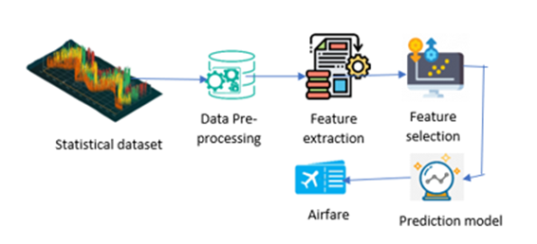
Methodology
Tools & Frameworks Used
Programming Language: Python
Development Environment: VS Code, Command Prompt
Machine Learning Library: Scikit-learn (Random Forest Regressor)
Data Processing: Pandas, NumPy
Web Framework: Flask (API), Streamlit (UI)
Data Storage: CSV File(Dataset)
Flight Price Prediction Model Data Flow

Slide 6
Methodology
Development Approach
Data Preprocessing – Clean and prepare flight price data.
Feature Engineering – Extract key influencing factors.
Model Training – Train Random Forest Regressor for predictions.
Evaluation & Optimization – Improve accuracy with tuning.
Web UI & API – Develop Streamlit UI and Flask API.
Testing & Deployment – Validate model and deploy system.
Data Collection
Source – Gather historical flight price data from online travel agencies and airline websites.
Features – Include airline, route, departure/arrival time, duration, stops, and fare.
Preprocessing – Handle missing values, remove duplicates, and format data.
Storage – Save cleaned data in CSV format for model training.

Slide 7
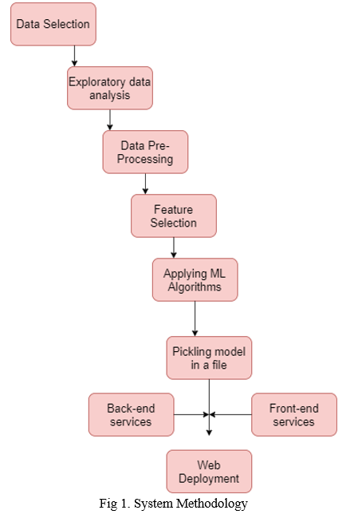
System Design / Architecture
User Interface (UI): A Streamlit-based web application for user input and predictions.
Backend: Flask API to process user requests and interact with the trained model.
Machine Learning Model: Random Forest Regressor trained on historical flight data.
Database: CSV files or cloud storage for storing processed flight data.
Deployment: Local execution via command prompt or potential cloud hosting.
Flight Price Prediction System Architecture

Slide 8
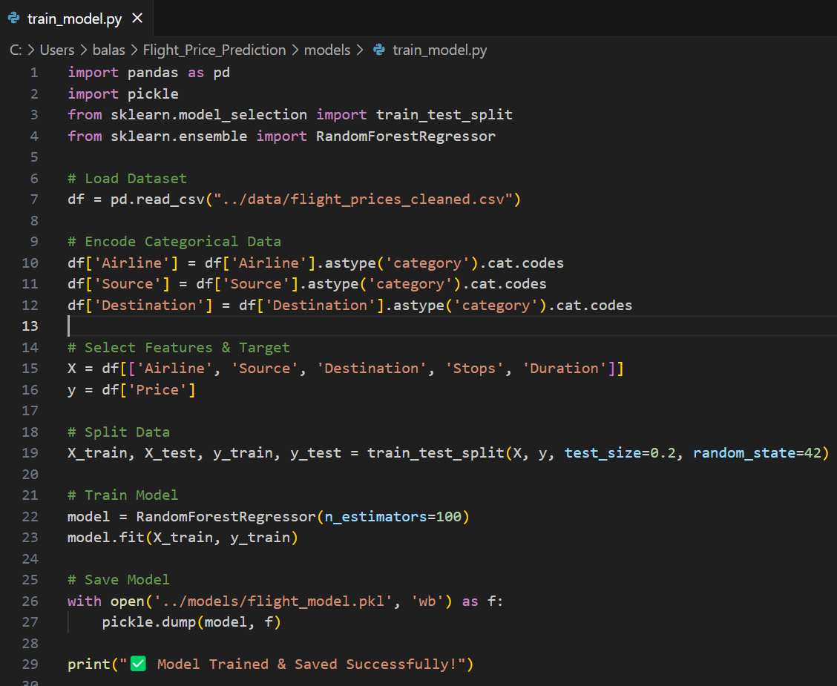
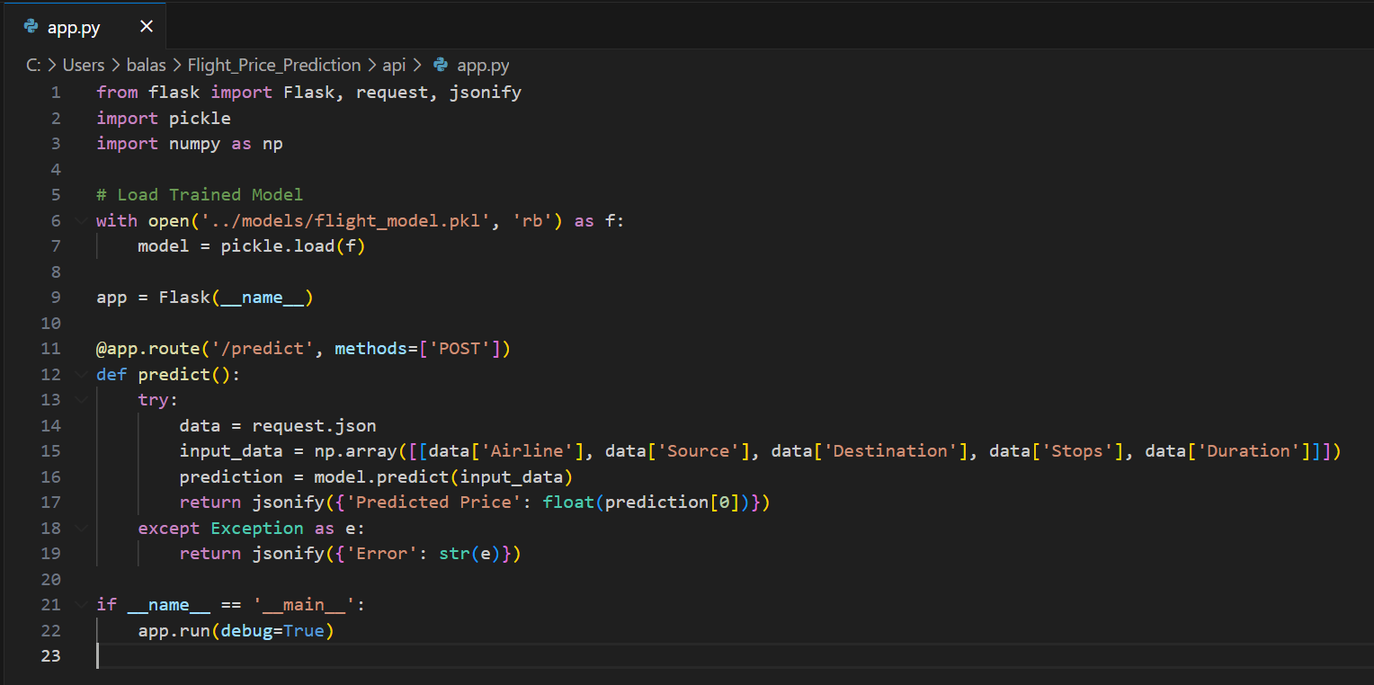
Implementation
Screenshots / Demos

Slide 9
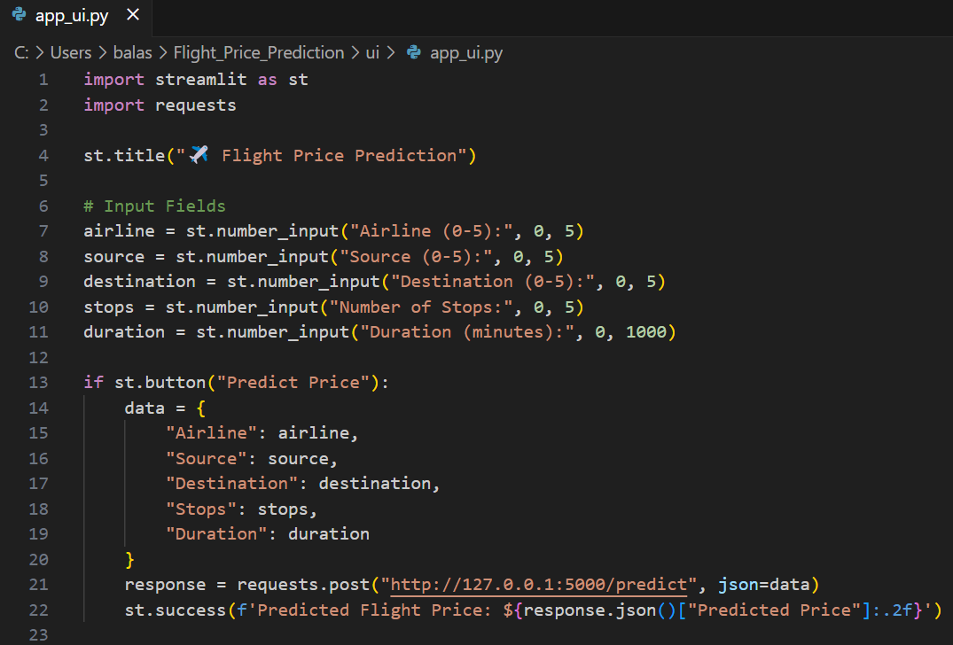
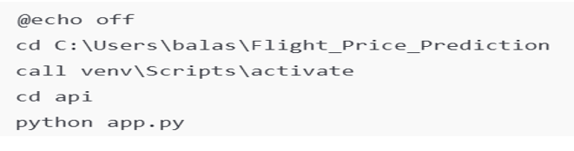
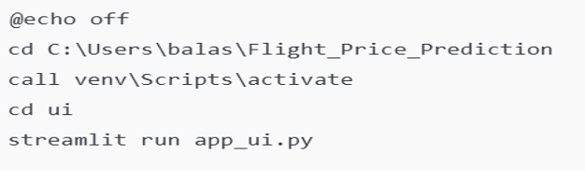
Implementation
Screenshots / Demos

Slide 10
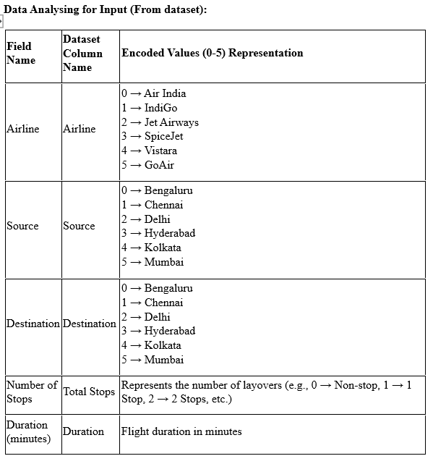
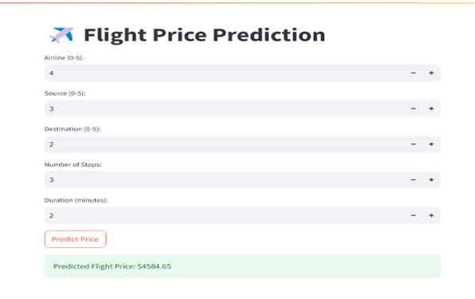
Implementation
Screenshots / Demos

Slide 11
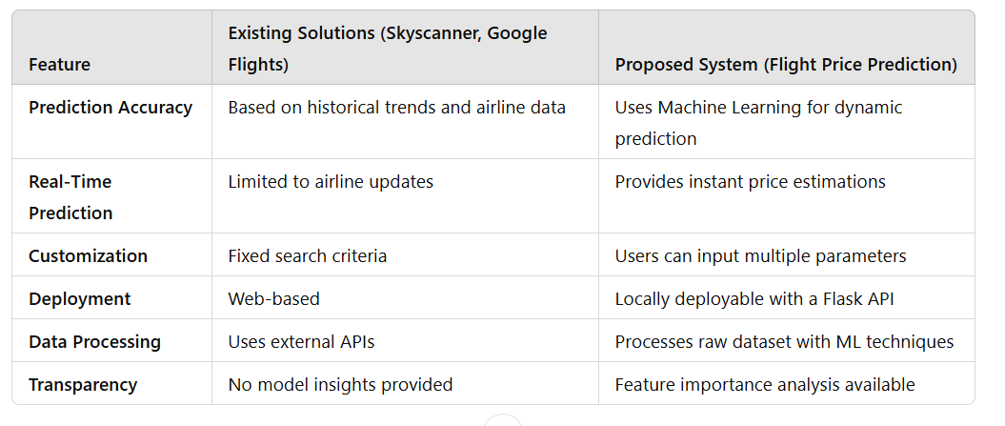
Results & Discussion
Comparison with Existing Solutions
Outcomes of the Project
Accurate Flight Price Prediction: The model provides reliable fare estimates based on input parameters.
User-Friendly Interface: A simple and interactive web application for easy access to predictions.
Optimized Model Performance: Random Forest Regressor ensures high accuracy and efficiency.
Real-Time Insights: Instant predictions help users plan and budget their travel effectively.

Slide 12
Results & Discussion
The Flight Price Prediction System was evaluated based on model performance, accuracy, and user experience.
Model Performance: The Random Forest Regressor achieved high accuracy in predicting flight prices, outperforming simpler models due to its ability to handle complex patterns in the dataset.
Feature Importance: The most influential factors in price prediction were airline type, duration, number of stops, and departure time.
User Experience: The Streamlit-based UI allowed users to input flight details and receive real-time price predictions efficiently.
Challenges: Some data inconsistencies, such as missing values and outliers, impacted initial predictions but were resolved through preprocessing techniques.
Comparison with Existing Systems: Unlike third-party flight aggregators, this system offers greater customization and transparency in how predictions are made.

Slide 13
Challenges & Limitations
Issues Faced During Development
Data Cleaning – Handling missing values and inconsistent formats.
Model Optimization – Fine-tuning Random Forest Regressor to improve accuracy.
Deployment – Debugging Flask API integration with Streamlit UI.
Computational Limits – Training large datasets efficiently.
Real-Time Accuracy – Ensuring reliable predictions for unseen data.
Possible Constraints
Data Availability – Limited access to real-time flight pricing data.
Model Accuracy – Predictions may vary due to market fluctuations.
Computational Resources – Training large datasets requires high processing power.
Deployment Limitations – Hosting constraints for Flask API and Streamlit UI.
Feature Selection – Some factors influencing flight prices may be unaccounted for.

Slide 14
Future Scope
Future Scope
Further Development
Multi-Factor Price Prediction – Incorporate weather, seasonal trends, and demand analysis.
Automated Booking Suggestions – Recommend the best time to book based on price trends.
Incorporating More ML Models – Experiment with deep learning and ensemble methods for better accuracy.
User Dashboard & Notifications – Alert users when prices drop for their preferred routes.
Real-Time Price Updates – Integrate live flight pricing APIs for dynamic predictions.
Advanced Machine Learning Models – Explore deep learning techniques for better accuracy.
User Personalization – Predict prices based on user preferences and travel history.
Global Expansion – Extend predictions to international flight routes.
Mobile App Integration – Develop a mobile-friendly version for better accessibility.

Slide 15
Conclusion
This project successfully developed a Flight Price Prediction system using machine learning techniques. By leveraging historical flight data and applying the Random Forest algorithm, the model provides accurate price estimations. The system helps users make informed booking decisions, reducing travel costs. Challenges such as data preprocessing and model tuning were addressed, leading to improved prediction accuracy. Future enhancements can include real-time data integration, additional ML models, and mobile app development to further optimize the system’s usability and performance.
Key Takeaways
ML for Predictions – Used Random Forest to predict flight prices.
Data Preprocessing – Improved accuracy with cleaning & feature scaling.
User-Friendly UI – Streamlit-based interface for easy access.
Challenges Solved – Handled data inconsistencies & model tuning.
Future Scope – Real-time data integration & mobile app expansion.

Slide 16
References
Rahimi, M., & Wang, X. (2020). Airfare Prediction using Machine Learning Algorithms. International Journal of Data Science, 7(3), 145–159.
IATA (2023). Global Airline Market Analysis and Trends. Retrieved from www.iata.org.
McKinsey & Company (2021). AI and Data Analytics in the Airline Industry. Retrieved from www.mckinsey.com.
Python Software Foundation (2024). Scikit-Learn: Machine Learning in Python. Retrieved from https://scikit-learn.org.
Kaggle (2024). Flight Price Prediction Dataset. Retrieved from https://www.kaggle.com.

Slide 17
THANK YOU !

